Slide 1



Predictive Models with XAI: A Comparative Study of Enhancing Airline Customer Satisfaction
Cloë C. E. van Geest, Yong Wan Yit, Zaur T. Gouliev, Keith Quille
December 14 2023 - HCAI-ep conference 2023
Notes:
1: introduce yourself, group, university, how did we come with this idea?
question: what is the most important factor for you in air travel?
2: outline of presentation
3: objectives and scope
4: data (‘used data preparation to reach this cleaned data’: source, boundaries/balances, features examples)
5: model development: first decision tree and then deep learning!! simple model first. justification of why these models.
what models (nn and dt), hyperparameters we tuned with range, graph of final network with number of neurons and metrics (why these metrics)
6: XAI: justification for lime/shap: followed the community and explain why they get similar performances between the models.
7: contributions
8: limitations / threats to validity
9: future work
10: questions?
focus: not too much on dt and nn, people know that. our data and XAI results is more important, because this is specific to our paper.

Slide 2
PRESENTATION OUTLINE
01
02
03
04
05
06
introduction
OBJECTIVES/SCOPES
DATA & METHODS
MAKING A CASE FOR AIRLINES, CSAT AND AI
PREDICTING CSAT BASED ON USER’S EXPERIENCES
DATA SOURCE, PREP, FACTORS
MODEL
XAI
conclusions
DEVELOPING A NEURAL NETWORK MODEL
DEMONSTRATING THE EXPLAINABILITY OF OUR OUTPUTS (XA)
CONTRIBUTIONS, LIMITATIONS AND FUTURE WORK
Notes:
1: introduce yourself, group, university, how did we come with this idea?
question: what is the most important factor for you in air travel?
2: outline of presentation
3: objectives and scope
4: data (‘used data preparation to reach this cleaned data’: source, boundaries/balances, features examples)
5: model development: first decision tree and then deep learning!! simple model first. justification of why these models.
what models (nn and dt), hyperparameters we tuned with range, graph of final network with number of neurons and metrics (why these metrics)
6: XAI: justification for lime/shap: followed the community and explain why they get similar performances between the models.
7: contributions
8: limitations / threats to validity
9: future work
10: questions?
focus: not too much on dt and nn, people know that. our data and XAI results is more important, because this is specific to our paper.

Slide 3

Fun Fact
In 2017, United Airline faced a reputation crisis when a viral video showed a passenger being forcibly removed from a flight. The stock price of the airline had dropped approximately 4% and facing customer boycotts during that time.
Even back in 2009, a musician’s guitar was damaged by United Airline’ baggage handler and he wrote a song called “United Breaks Guitars” that went viral on Youtube. This incident also damaged United Airlines’ reputation.
YouTube: United Breaks Guitars
Notes:
Airlines with higher satisfaction tend to have more loyal customers. People (passengers) satisfaction can quickly make or break an airline’s reputation.

Slide 4


What is the most important factor for you in air travel?
ⓘ
Click Present with Slido or install our Chrome extension to activate this poll while presenting.
Notes:
📣 This is Slido interaction slide, please don't delete it. ✅ Click on 'Present with Slido' and the poll will launch automatically when you get to this slide.

Slide 5
Airlines
Accurate prediction of customer satisfaction has significant practical implications for airlines. It empowers them to tailor services, allocate resources efficiently, and elevate customer experiences, ultimately leading to improved customer loyalty and business growth.

Slide 6
Objectives and scope
Leverage explainable AI to forecast customer satisfaction within the airline industry
Provide insights into a glassbox approach: show how decision tree provides visual presentation of influential factors, making it easier to grasp
Provide insights into a blackbox approach: show how neural network has the ability to deal with complex multi-faceted datasets
Examine factors influencing customer satisfaction in the airline industry
Looked at 2 AI approaches, 2 XAI tools
and specific dataset (before Covid-19)

Slide 7
Data
Open source data set
Provided by IIT Roorkee in 2020 as part of a tech competition
The airline stayed anonymous, was referred to as ‘Invistico Airlines’
129980 data entries
23 factors
393 missing (0.3%)
hot-encoded variables
Notes:
used data preparation to reach this cleaned data

Slide 8
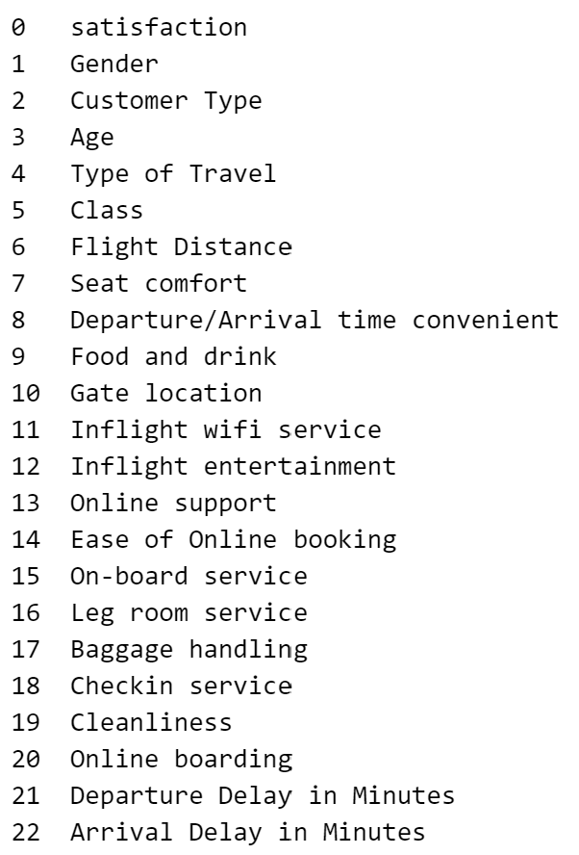
Deep dive into the data
Encoded Categorical Variables
 | 0 | 1 | 2
Satisfaction | Dissatisfied | Satisfied
Gender | Female | Male
Customer Type | Disloyal Customer | Loyal Customer
Type of Travel | Personal Travel | Business Travel
Class | Business | Eco | Eco Plus
Notes:
We explored it using Pandas, and from the output, we observe that there are 23 columns, including a mix of numerical and categorical features. The dataset consisted of 129,880 rows and 23 columns. here are 393 missing entries in the 'Arrival Delay in Minutes' column. Given the small percentage (0.3%) of missing values and the high correlation with 'Departure Delay in Minutes,' we choose to remove these instances.
Our data prep involved handling missing values, and encoding categorical variables. We did EDA and found the distribution of key variables and their correlations with customer satisfaction, providing good info before moving on to preprocessing for a model development. Some visualisations of this are on the next page

Slide 9
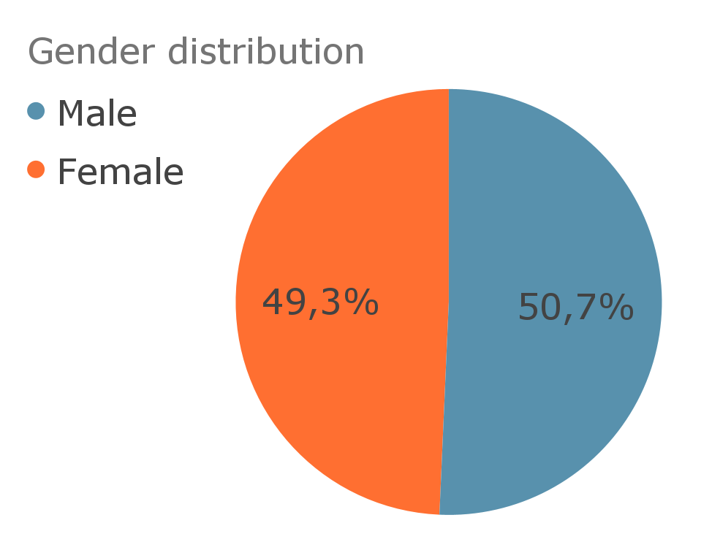
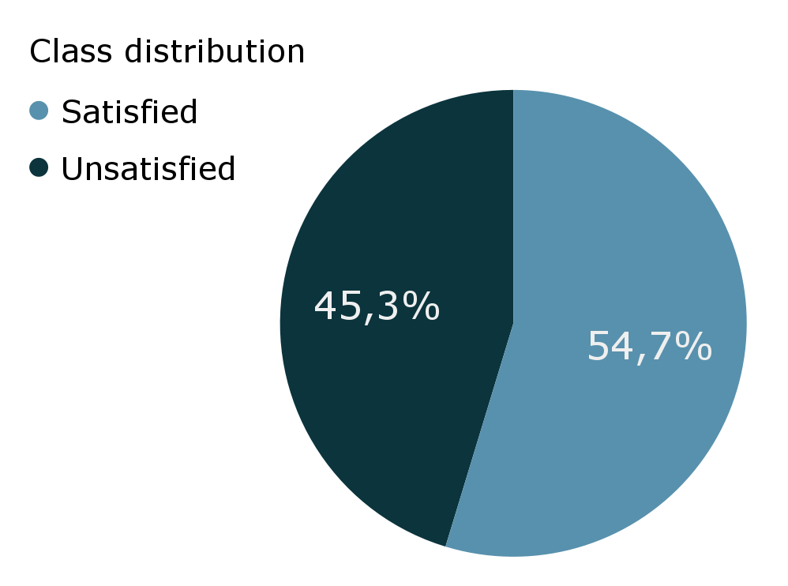
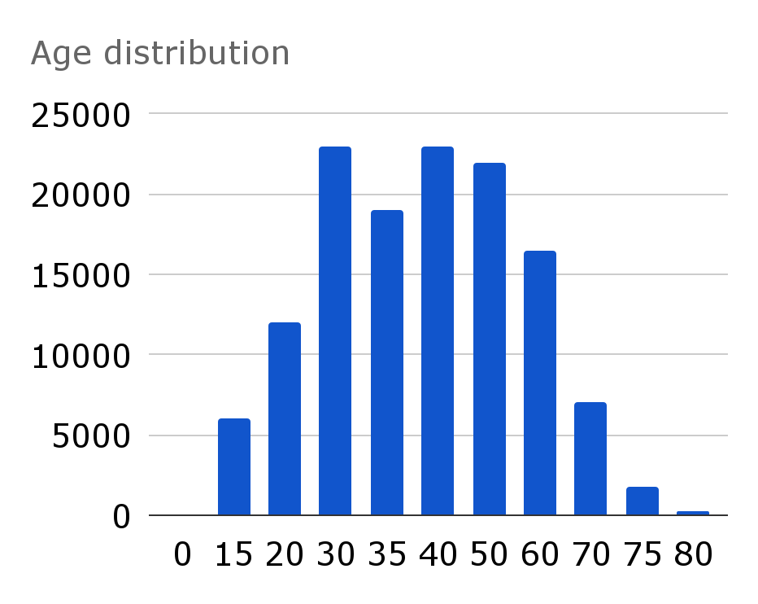
Descriptive analysis
Notes:
We begin by loading the dataset using the Pandas library. It contains information related to customer satisfaction with an airline.
We explored it using Pandas, and from the output, we observe that there are 23 columns, including a mix of numerical and categorical features. The dataset consisted of 129,880 rows and 23 columns. here are 393 missing entries in the 'Arrival Delay in Minutes' column. Given the small percentage (0.3%) of missing values and the high correlation with 'Departure Delay in Minutes,' we choose to remove these instances.
To prepare the dataset for modeling, we encode categorical variables into numerical representations. We provide a mapping for the following categorical variables: 'satisfaction' 'Gender' 'Customer Type' 'Type of Travel' 'Class'.
Our data prep involved handling missing values, and encoding categorical variables. We did EDA and found the distribution of key variables and their correlations with customer satisfaction, providing good info before moving on to preprocessing for a model development. Some visualisations of this are on the next page
Mean age: 39

Slide 10
04
Model development
Glassbox (Decision Tree)
Blackbox (Neural Network)
Notes:
model development: first decision tree and then deep learning!! simple model first. justification of why these models.

Slide 11
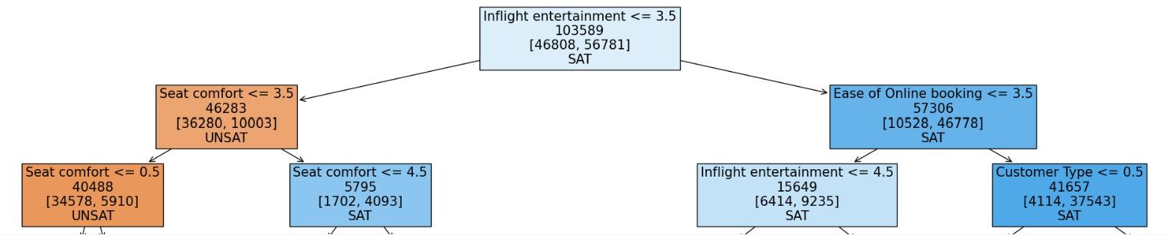

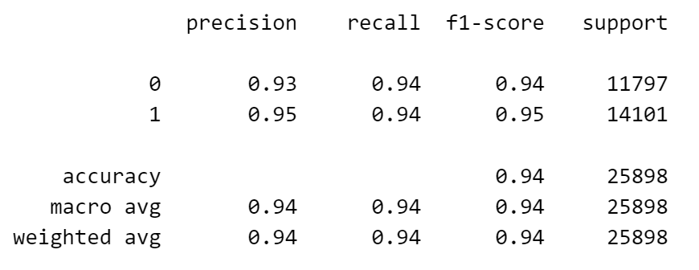
glassbox approach - Decision tree classifier
Depth of 2 to improve interpretability
Accuracy of 94%
Notes:
Glassbox: tree with depth 2 so it is interpretable.
First step: inflight entertainment to decide left (low) or right (high) branch.
left branch: go to seat comfort.
For customers in the left branch (unsatisfied with inflight entertainment), if "Seat comfort" is also rated as less than or equal to 3.50, they are assigned to class 0 (UNSAT). This indicates that customers who are
unhappy with both inflight entertainment and seat comfort are predicted to be dissatisfied with their overall experience.
right branch: go to ease of online booking but always satisfied.
This implies that customers who are content with inflight entertainment but find online booking difficult, are still predicted to have an overall positive experience.
evaluation: 94% accuracy
hyperparameters we tuned with range, graph of final network with number of neurons and metrics (why these metrics)

Slide 12
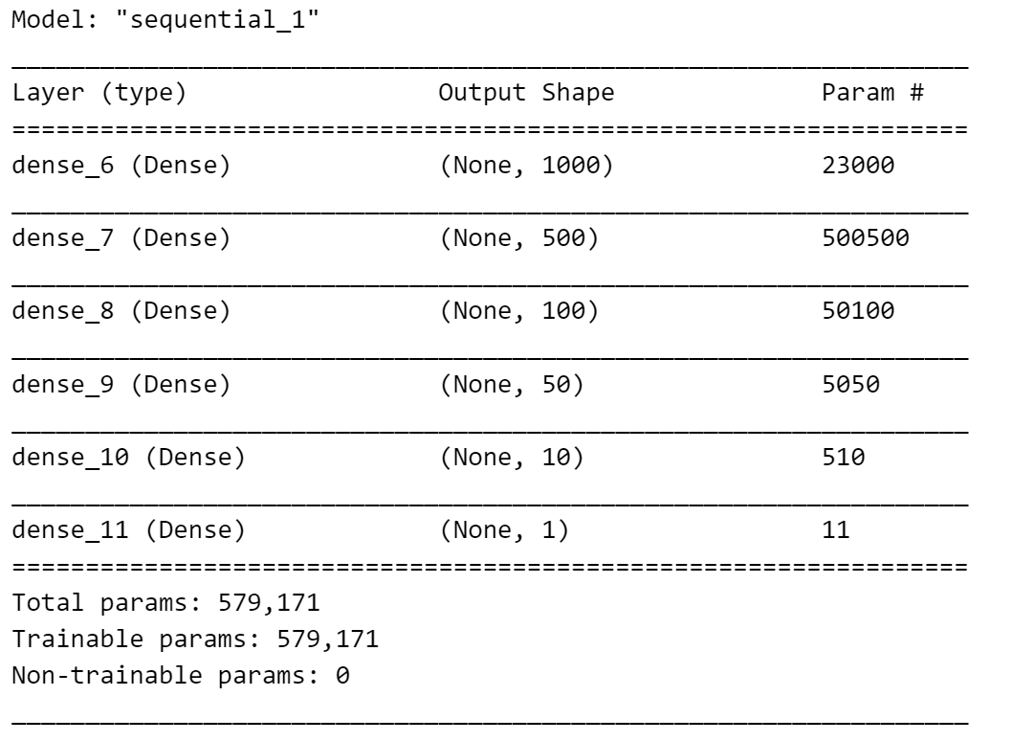
Blackbox approach - Neural network
development
Several experimentations aimed at best accuracy and reducing loss function for this dataset
Ultimately the selected model reached 92% accuracy
Notes:
Our rationale and justification for using this particular configuration of hyper-parameters was based on several experimentation that was aimed at getting the best accuracy and reducing the loss function in this particular dataset
The choice of the ReLU activation function helps the model capture complex patterns within the data.
To facilitate binary classification (satisfied or dissatisfied), we employed a sigmoid activation function in the output layer. The model was trained using binary cross-entropy loss and optimized with the Adam optimizer. During training, we ran the model for 100
epochs, utilizing a batch size of 1000 and assessing its performance on a validation dataset

Slide 13
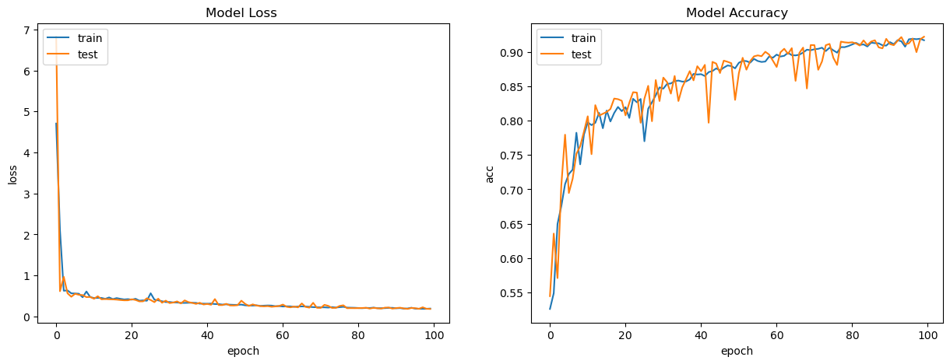

Slide 14
 | accuracy | precision | recall | f1-score
Glassbox | 94% | 95% | 94% | 95%
blackbox | 92% | 97% | 88% | 93%

Slide 15
05
eXplainable ai
LIME
SHAP
Notes:
justification for lime/shap: followed the community and explain why they get similar performances between the models.

Slide 16
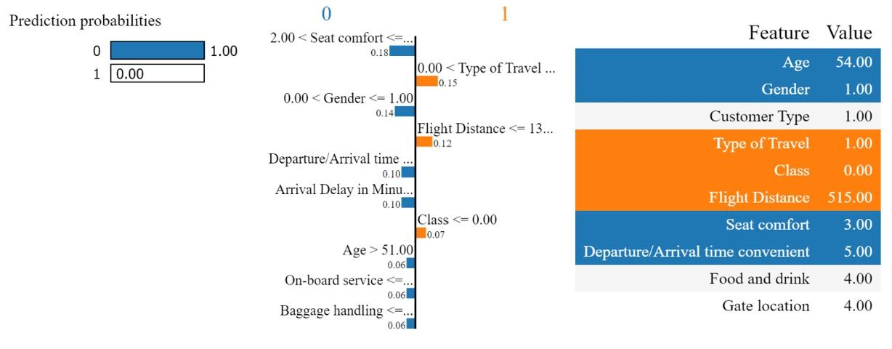
XAI - Lime
LIME for local explanations of instances
Notes:
what XAI techniques did we apply
what did their results show?
can we explain these results?
For both LIME and SHAP, the graphs show that seat comfort and inflight entertainment are the biggest contributing factors. That is, these factors have the biggest weights for both classes. Meaning that if either is negative (bad seats and/or no entertainment), it has a big negative impact. If they are positive (great seat and/or a lot of entertainment), they have a large positive impact. For example, the last SHAP graph shows that the average impact of the model's output for class 0 (dissatisfied) for seat comfort (for the 5 presented cases) was 0.13 and the model's output for inflight entertainment was 0.8. These are much higher than the other features. Indeed this is not a surprising result. Intuitively, these factors would make a flight more or less comfortable.
True Prediction: The index of the example in the dataset.
Predicted Class: The class predicted by the model for this example (0 for "Dissatisfied" and 1 for "Satisfied").
Actual Class: The true class label for this example.
Prediction probabilities: The predicted probabilities for both classes ("Dissatisfied" and "Satisfied").
Explanation: Lime's explanation for the prediction, showing the top contributing features along with their impact.
LIME Explanation using Softmax and Sparse Categorical Crossentropy
We are using the LIME (Local Interpretable Model-agnostic Explanations) technique to explain the predictions of a model trained with softmax activation and sparse categorical crossentropy loss.
Output
-- The output shows the original prediction probabilities for these two classes: "Satisfied" (with a probability of 0.55) and "Unsatisfied" (with a probability of 0.45) --
Class 0: 0.76 Class 1: 0.24 Overall, this code is used for explaining why a machine learning model made false predictions by displaying the predicted probabilities, feature importance, and feature values for the problematic data points. It helps you understand which features had the most influence on the model's incorrect predictions.

Slide 17
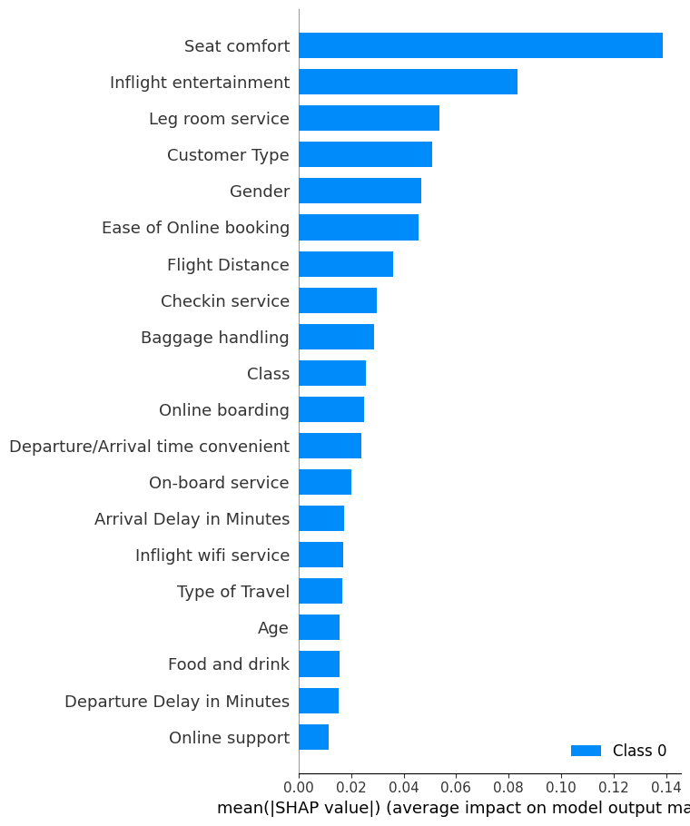
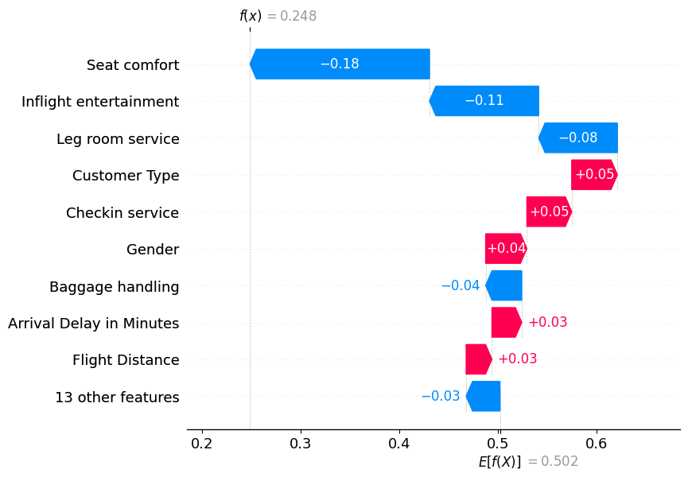
XAI - Shap
Can be used for both local and global explanations of predictions
Notes:
SHAP (SHapley Additive exPlanations) values were used to explain the predictions made by the neural network model.
SHAP values provided insights into the contribution of individual features to each prediction.

Slide 18
contributions
Analyzed multi-faceted data set on customer satisfaction in airline industry through a glassbox and blackbox approach
Effectively applied two XAI techniques to explain the blackbox approach further
While XAI helps to make blackbox approach transparent, the glassbox also achieves high accuracy and is interpretable on its own
Model excelled in predicting the satisfied class, with ‘Seat Comfort’ and ‘Inflight Entertainment’ as most predictive factors

Slide 19
limitations
&
Future work
XAI showed Gender as predictive factor for customer satisfaction
Static historical data (before Covid-19)
In-depth analysis of gender specific preferences in air travel
Dynamic streaming data and continuous learning models
Personalized preferences
Multi-model approach
Notes:
Understanding whether there are gender-specific preferences or concerns could lead to more targeted strategies for enhancing passenger experiences.
Personalized: include travel history and research into loyalty programs
Ensemble models could be included if data gets more complex and decision tree is not applicable anymore, or to enrich scope of study

Slide 20
THANKS!
DO YOU HAVE ANY QUESTIONS?
x00204826@mytudublin.ie
https://doi.org/10.1145/3633083.3633189

